Slide 1
Capstone 1
Tennis match predictor

Slide 2
Problem
Use data analytics to predict the results of a US Open tennis match.
The US Open is the highest paid tennis event in the world, with total prize monies of $50,400,000.
The US Open is one of four Grand Slam tournaments, and also one of the only tournaments to evenly pay both the men and women champions.

Slide 3
Features in data model
'p1_points', 'p2_points‘ := Number of ATP tour points
'p1_rank', 'p2_rank‘ := ATP player ranking
'p1_seed', 'p2_seed‘ := Tournament seed of player
'p1_age', 'p2_age‘ := Age of player
'p1_ioc', 'p2_ioc‘ := Country of player
'p1_hand', ‘p2_hand‘ := Dominant hand of player
‘p1_ht’,’p2_ht’ := Height of player
'level‘ := Level of tournament (Grand Slam, Masters, etc.)
'date‘ := Date of match
'winner‘ := Winner of match (Randomly assigned player 1 or 2)

Slide 4
Data wrangling and assumptions
Matches from 1968 to 2016
163,577 matches in data set
Only looked at hard court matches
63,460 matches in data set
Removed matches that had incomplete/missing fields
5,277 matches in data set

Slide 5
Algorithms
Logistic Regression
SVC

Slide 6
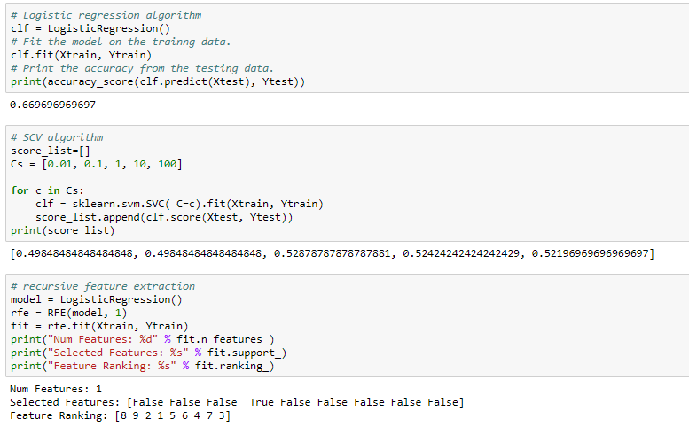
Results – All 10 features

Slide 7
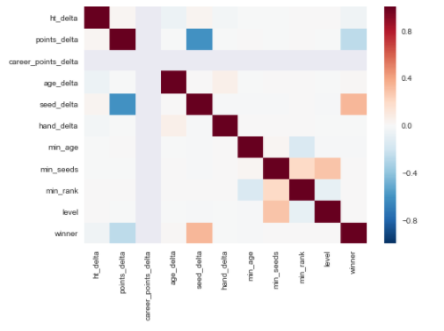
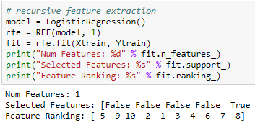
Feature analysis and correlation test

Slide 8

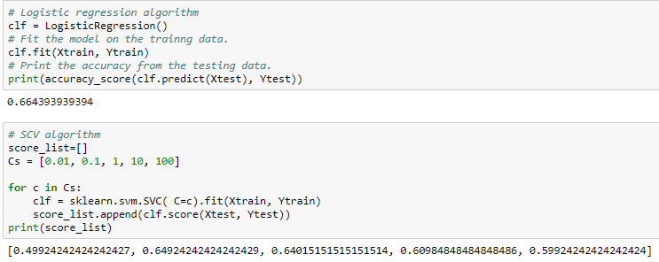
Best Result – 4 features

Slide 9
Conclusion
Number of ATP points was negatively correlated to the match winner.
Tournament seed was the highest correlated feature
Features that could improve the model:
Head to Head match history
Performance statistics like % 1st serve, ace, winners, etc.

